Slide 1

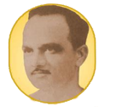
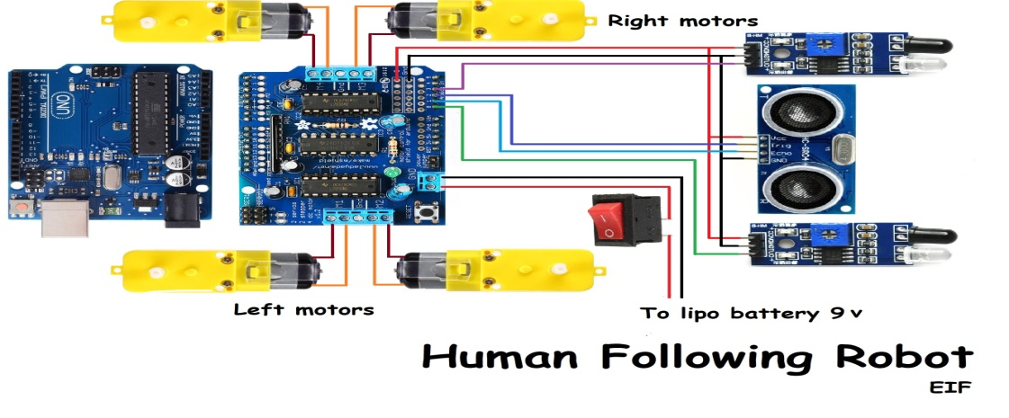
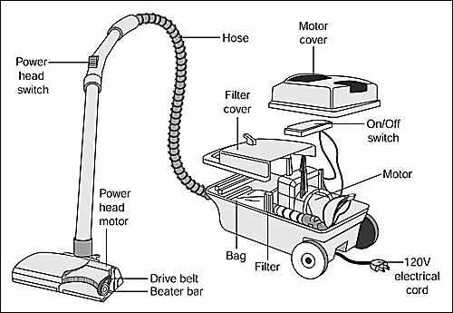

 | ANANTRAO PAWAR COLLEGE OF ENGINEERING & RESEARCH INTERNET OF THINGS CONTROLLING ROBOT BY USING GOOGLE ASSISTANT ,BLUETOOTH AND VOICE COMMAND Mentor: Prof. Anil Lohar Academic Year:2023-24 Kawade Pavan, Magar Swapnil, Patil Nikhil , Sawant Shivaji
INTRODUCTION
Robot Platform: The heart of the project is a robot platform equipped with motors and wheels for movement. Microcontroller: A microcontroller, such as Arduino or Raspberry Pi, serves as the brain of the robot. It processes incoming voice commands, controls the robot's movements, and manages the Bluetooth communication.
OBJECTIVE
Voice-Activated Control: Enable users to control the robot through voice commands, creating an intuitive and hands-free interaction. Integration with Google Assistant: Utilize Google Assistant's voice recognition capabilities to understand and process user commands effectively. Bluetooth Connectivity: Establish a stable Bluetooth connection between the user's device and the robot's microcontroller to enable real-time communication.
METHODOLOGY
WORKING MODEL
SOFTWARE REQUIREMENTS
Voice Recognition Software Mobile App Arduino NLTK (Natural Language Toolkit) Robot Control Software
CONCLUSION
Creating a robot controlled by google assistant, Bluetooth, and voice commands involves a combination of hardware and software integration. This project brings together technologies such as Arduino or raspberry pi for the robot's physical control, Bluetooth for wireless communication, and google assistant for voice command recognition. The collaborative efforts of open-source communities, hardware manufacturers, and cloud service providers contribute significantly to the successful implementation of such projects.
ACKNOWLEDGEMENT
In the development of a robot controlled through Google Assistant, Bluetooth, and voice commands, it is crucial to acknowledge the collaborative efforts and contributions of various individuals and communities. The integration of hardware components, such as Arduino or Raspberry Pi, motor drivers, and Bluetooth modules like HC-05, owes much to the open-source community's wealth of code and tutorials.
REFERENCES
C.o. iRobot, ‘‘iRobot: Our History,” 29 May 2015. [Online]. Available, M. M. Bijaieh, W. W. Weaver, and R. D. Robinett, “Effects droop settings on energy storage systems of inverter-based microgrids,” Electrical Drives, Automation and Motion pp. 75–80, June 2018.
PROJECT WORK

